Slide 1
Algorithms
By: Will Johnson, Austin Kincade, Colton Moore, Braden Rice, Jacob Gregory, & Alex Shnyrov

Slide 2
different ways to design algorithms
Petri-nets
Noun Extraction
Flow Charts
State Management
Sequence Diagrams

Slide 3
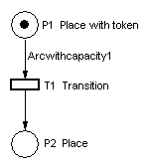
Petri-Nets
Technique to visually model various kinds of dynamic event-driven systems.
Useful for keeping track of the current state by using “tokens”.
A Petri-net is a type of bipartite directed graph. They consist of three objects: [11]
Places (Represents a state)
Transitions (Fires/activates if all conditions are met)
Directed arcs (Connects places to transitions or transitions to places)
In its simplest form, petri-nets visualize transitions from inputs to outputs. [11]
[11]

Slide 4
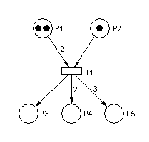
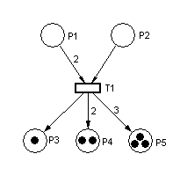
Petri-nets
A Transition will fire if all input conditions are met.
A met condition from an input will be represented by placing a “token(s)” on that “place”.
When a transition fires: [8]
Remove a number of tokens from each input equal to their weight.
Place a number of tokens on each output equal to their weight.
Weight will generally be denoted by a number next to the directed arc, or by the number of arrows. (Default weight is 1) [8], [11]
Pre-fire [11]
Post-fire [11]
Notes:
(Multiple select) Select all that are true about Petri-nets. (6 points)
[ ] When a transition fires, ALL tokens should be removed from its inputs.
[x] A directed arc with no number denoting its weight has a weight of 1.
[x] A “place” can only point to a “transition”, and a “transition” can only point to a “place”.
[ ] A transition will fire if any of the input conditions are met.
[x] A token(s) represents a state’s condition as being met.

Slide 5
Noun Extraction
Multi-stage process used to define the classes of a project, the variables in each, and each of their functions
Nouns-> Classes and class variables
Verbs-> class functions
Notes:
What are the stages of Noun Extraction (match the stage with the number?
Creating an SRS -- Describe the product
Going through a description of the product and looking for classes that fit within the product domain -- Identify the nouns
Creating notecards with each class name on them -- Make the cards for each noun
Going through a description of the product and looking for functions that a class would be able to do -- Identify the verbs associated with each noun
Arranging different cards based on how they are related or how they interact -- Determine the Dependencies
Writing a short description of the project and what it is meant to do -- Describe the product
Highlighting every noun in a description of the product -- Identify the nouns
Highlight every verb in a description of the product -- Identify the verbs associated with each noun
Ask a stakeholder to write a brief overview of how they want the product to function -- Describe the product

Slide 6
Stage 1: Describe the Product
Buttons in elevators and on the floors control the movement of n elevators in a building with m floors. Buttons illuminate when pressed to request the elevator to stop at a specific floor; the illumination is canceled when the request has been satisfied. When an elevator has no requests, it remains at its current floor with its doors closed

Slide 7
Stage Two: Identify the Nouns
Buttons in elevators and on the floors control the movement of n elevators in a building with m floors. Buttons illuminate when pressed to request the elevator to stop at a specific floor; the illumination is canceled when the request has been satisfied. When an elevator has no requests, it remains at its current floor with its doors closed
Floor, Building and Door do not belong to this project
Movement, Illumination and Request are abstract nouns that would be more like attributes to concrete nouns
This leaves only buttons and elevators

Slide 8


Stage 3: Make cards for each noun
Put a noun on each card. These represent the classes

Slide 9
Stage Four: Identify the verbs associated with each noun
Buttons in elevators and on the floors control the movement of n elevators in a building with m floors. Buttons illuminate when pressed to request the elevator to stop at a specific floor; the illumination is canceled when the request has been satisfied. When an elevator has no requests, it remains at its current floor with its doors closed
Use these verbs to form the functions and variables in each class

Slide 10

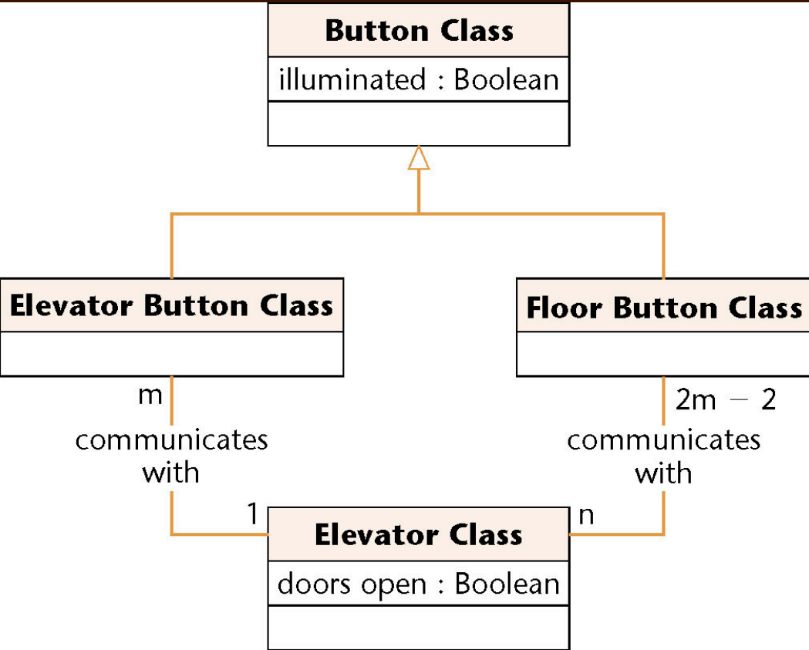
Stage 5: Determine Dependencies

Slide 11
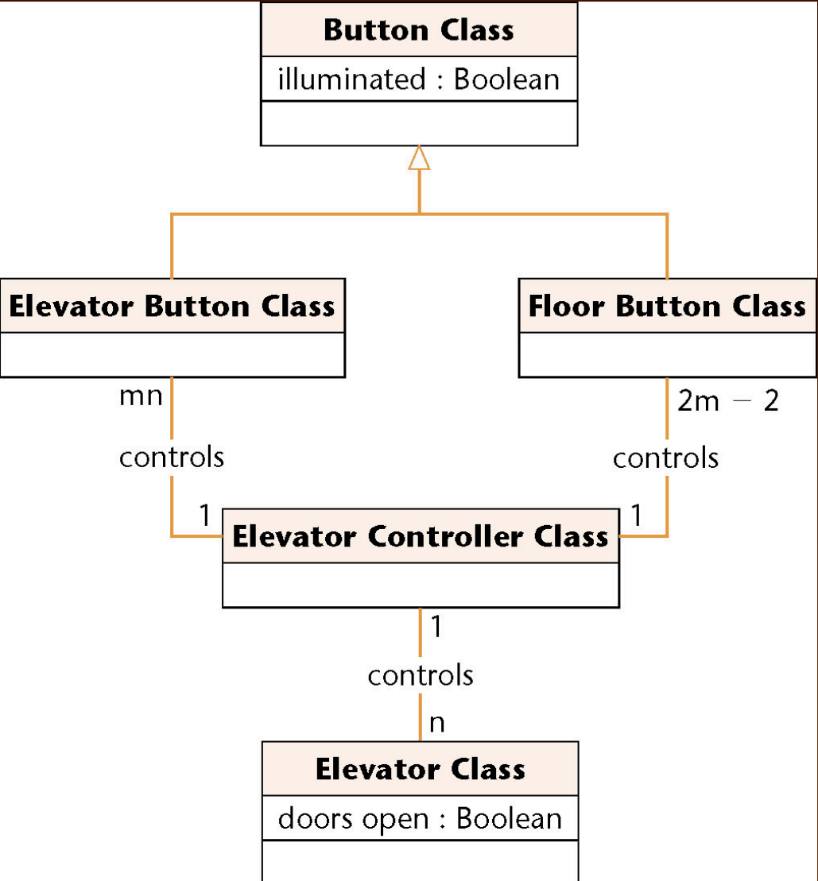
What the noun cards are lacking

Slide 12
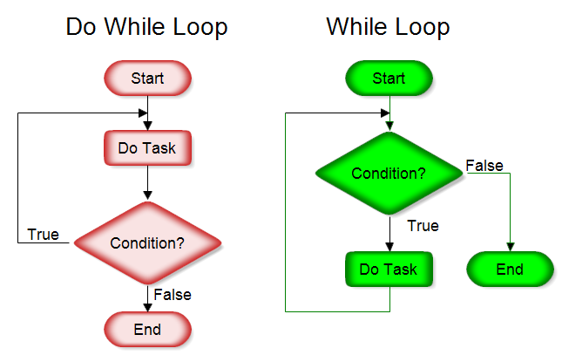
Flow-Charts
Flowcharts represent a workflow or process. They are representations of an algorithm, a step-by-step approach to solving a task.
They trace a process step by step through a series of boxes representing starts/ends, input/output, a process, or a decisions among other things.

Slide 13
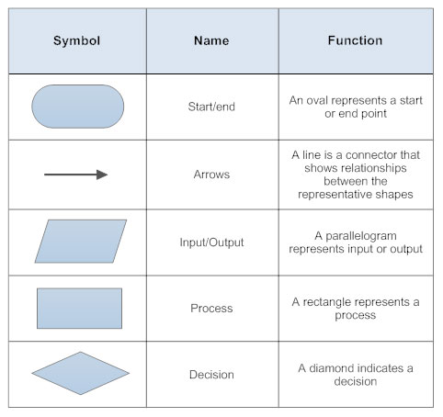
Standard basic shapes
The components of a flowchart are simple and easy to understand
While there are other shapes, these are the most commonly used.

Slide 14
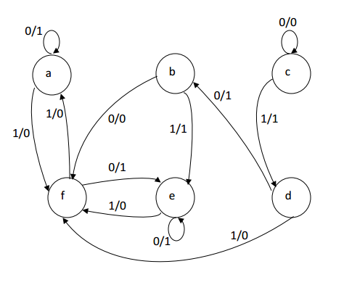

Slide 15
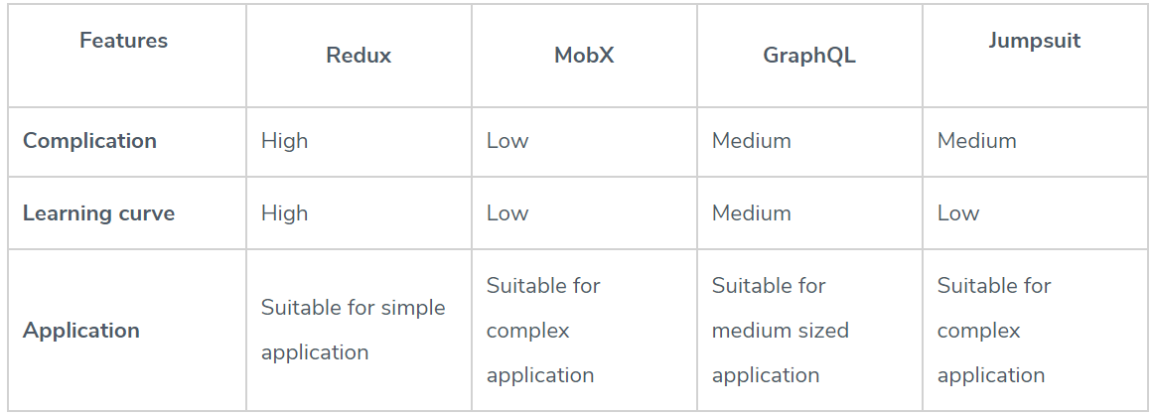
State Management

Slide 16
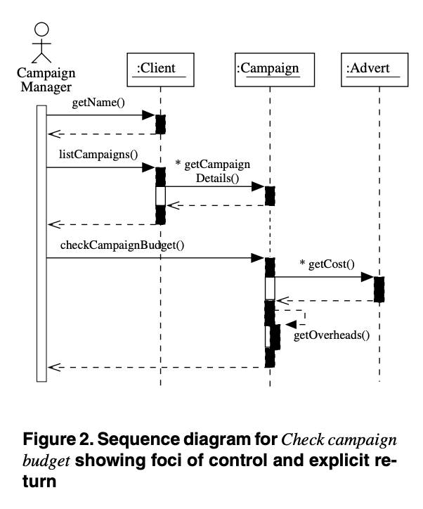
Sequence Diagrams
"The sequence diagram is used primarily to show the interactions between objects in the sequential order that those interactions occur." [1]
Graphical Notation for specification of message interaction [3]
Used to show how a system will communicate
Can be used to refine requirements and express use cases [1]
[ 2 ]

Slide 17
Sources
[1] Bell, Donald. "UML basics: The sequence diagram." Diakses dari http://www. ibm. com/developerworks/rational/library/3101. html (2004). [ Corporation ]
[2] Dalton, Jeff. “Great Big Agile: An OS for Agile Leaders.” O'Reilly | Safari, Apress, learning.oreilly.com/library/view/great-big-agile/9781484242063/html/470826_1_En_23_Chapter.xhtml.
[3] Li, Xiaoshan, Zhiming Liu, and He Jifeng. "A formal semantics of UML sequence diagram." 2004 Australian Software Engineering Conference. Proceedings.. IEEE, 2004. [ IEEE / University ]
[4] Lund, Mass Soldal. "Operational analysis of sequence diagram specifications." (2007). [ University of Oslo ]
[5] Myers, Bob. “Analysis: Finding the Classes and Objects.” Analysis: Finding the Classes and Objects, www.cs.fsu.edu/~myers/cop3331/notes/analysis1.html.
[6] “Programming in Nouns and Verbs.” Wm. Barrett Simms, 26 Aug. 2016, wbsimms.com/programming-nouns-verbs/.
[7] Schach, Stephen R. Object-Oriented and Classical Software Engineering. The McGraw-Hill Companies, users.csc.calpoly.edu/~csturner/courses/308w09/Schach_ch12.pdf
[8] Sharov, Alexei. “Petri Nets.” Petri Nets, 26 Dec. 1995, web.ma.utexas.edu/users/davis/375/popecol/lec1/petrinet.html.
[9] Udacity. “Example Sequence Diagram.” YouTube, YouTube, 23 Feb. 2015, www.youtube.com/watch?v=Vjb86eQgHsA. [Video]
[10] VisualParadigm. “5 Steps to Draw a Sequence Diagram.” YouTube, YouTube, 13 Nov. 2011, www.youtube.com/watch?v=18_kVlQMavE. [ Video ]
[11] Wang, Jiacun. “Petri Nets for Dynamic Event-Driven System Modeling.” Blue Hawk, bluehawk.monmouth.edu/~jwang/Petri%20Nets%20--%20Introduction.pdf
[12] "What is an algorithm and why should you care?" Khan Academy. &lt; www.khanacademy.org/computing/computer-science/algorithms/intro-to-algorithms/v/what-are-algorithms&gt;.

